Slide 1
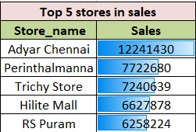
Top 5 stores in sales

Slide 2
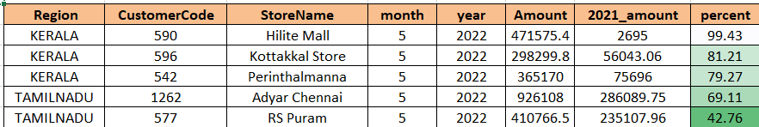
b)which store is performing better comparing to the previous year

Slide 3
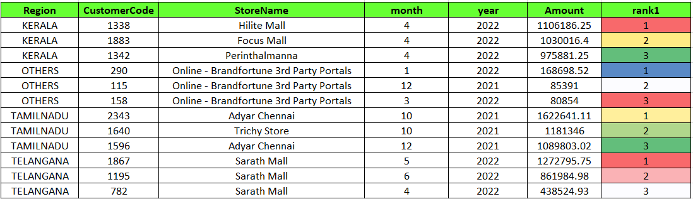
c.) Display the top 3 sales that happened in each region.

Slide 4
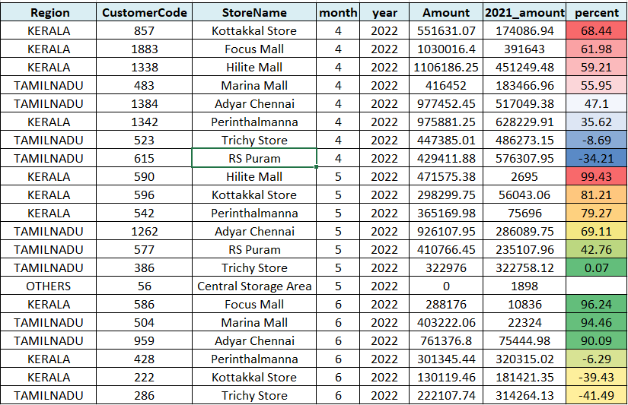
D) Give the contribution of sales by region

Slide 5
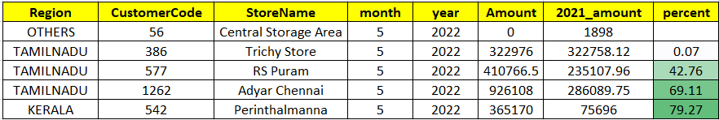
e)Display low performing stores by region.

